Slide 1

CMR TECHNICAL CAMPUS Accredited by NBA, Approved by AICTE, affiliated to JNTUH Kandlakoya (V), Medchal Road, Hyderabad -501401
DEPARTMENT OF COMPUTER SCIENCE AND ENGINEERING
Designing an Intellective Gaming Using Unity User Interface
Under the guidance
G.Latha Presented by
SK Saifuddin (177R1A05H4)
M Nishanth Reddy (177R1A05F6)
T Abhilash (177R1A05N3)

Slide 2
CONTENT
Abstract
Existing System
Disadvantages
Proposed System
Advantages
Hardware Requirements
Software Requirements
Project Architecture
Modules
UML diagrams
Sample code
Results
Conclusion
Future Enhancemet

Slide 3
ABSTRACT
The word cognition comes from the Latin root cognoscere, which means “to know”. By
cognition, we are usually referring to everything that is related to knowledge.
This project focuses on three core cognitive abilities. We used unity game engine to
create a game to improve cognitive skills of the players without any special immersive
techniques.

Slide 4
EXISTING SYSTEM
There are many cognitive games in the play store and online. Some of them focus on all
around cognitive skill sets. While others focus on some particular skills that are required for some selected audience(players)
LUMINOSITY
ELEVATE
BRAINGLE

Slide 5
DISADVANTAGES
We know video games can generate addiction issues. With cognitive games the chances of addiction are more than any normal games.
The excessive use of video games can cause rejection towards other didactic means such as books etc.

Slide 6
PROPOSED SYSTEM
We divide our games and activities into 3 critical brain areas: Memory, attention, language. We keep track of your progress and the games are based on scientific research.
Memory improvement is part of this memory game, the process can be done with a few steps that can be easy and performed effortlessly.

Slide 7
ADVANTAGES
Sharpening a child’s thinking skills means that he or she will have the mental aptitude to process information, make decisions, create new ideas, ask questions, try to make sense of things, organize information and so forth.

Slide 8
HARDWARE REQUIREMENTS
Processor Intel i5 core @ CPU 2.4GHz
RAM 8GB
Storage 25GB
GPU Nvidia geforce 970

Slide 9
SOFTWARE REQUIREMENTS
Operating System Windows 10
Languages C#
Engine Unity
IDE Visual studio community 2019
Browser Google Chrome, Edge

Slide 10
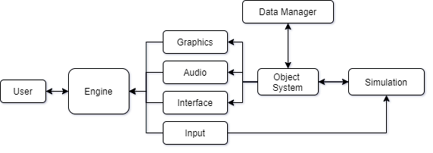
PROJECT ARCHITECTURE

Slide 11
UML DIAGRAMS
Use case diagram
Class diagram
Sequence diagram
Activity diagram

Slide 12
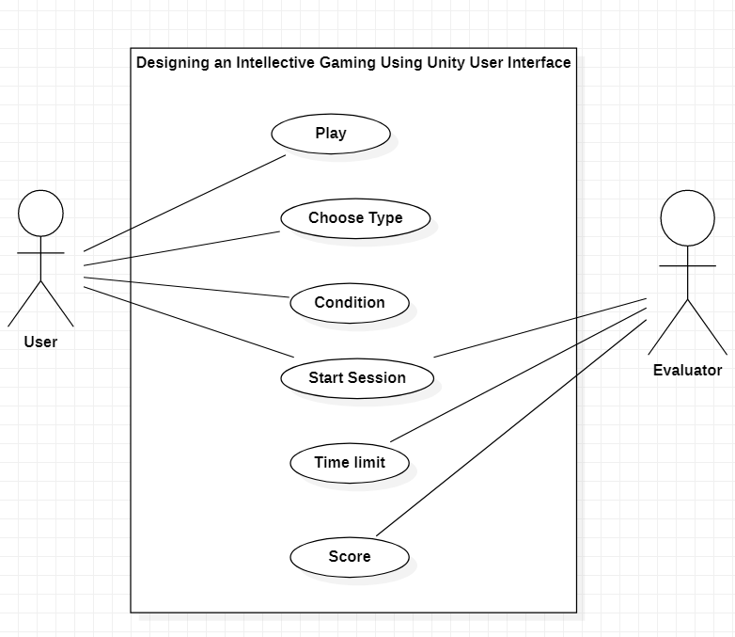
USE CASE DIAGRAM

Slide 13
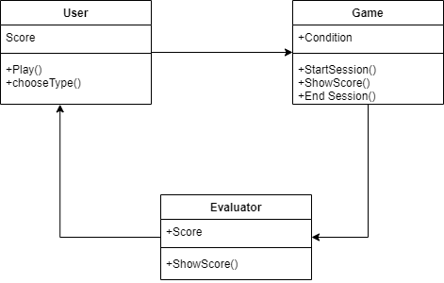
CLASS DIAGRAM

Slide 14
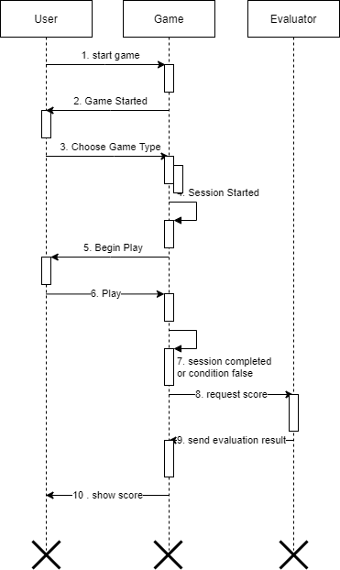
SEQUENCE DIAGRAM

Slide 15
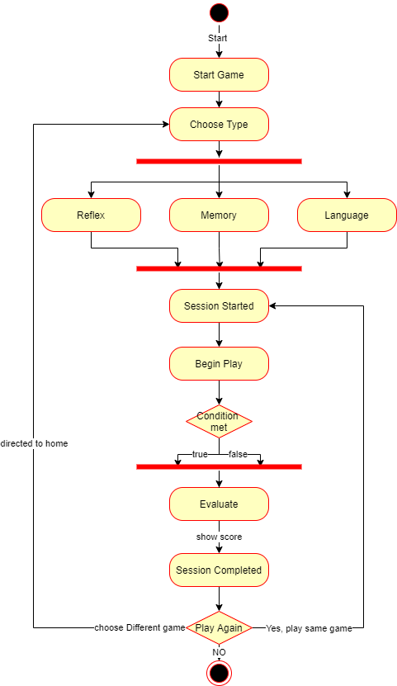
ACTIVITY DIAGRAM

Slide 16
Sample Code
using System.Collections;
using System.Collections.Generic;
using UnityEngine;
using UnityEngine.UI;
using System.IO;
using UnityEngine.SceneManagement;
public class ReflexioneTwo_GameManager : MonoBehaviour
{
public GameObject entryCanvas;
public void beginGame()
{
entryCanvas.SetActive(false);
}
public GameObject[] containers;
public Text levelText;

Slide 17
public Text highScoreText;
public Text playerturn;
private int level
{
get; set;
}
private int highScore
{
get; set;
}
private float duration
{
get; set;
}
private GameObject[] gameChoosedContainers;
private List<GameObject> playerChoosedContainers = new List<GameObject>();
void Start()
{
level = 1;
string[] lines = File.ReadAllLines("Assets/Resources/ReflexioneTwoResources/SavedData.txt");

Slide 18
string[] splitted = lines[lines.Length - 1].Split('$');
highScore = int.Parse(splitted[1]);
highScoreText.text = highScore.ToString();
levelText.text = level.ToString();
duration = 1f;
}

Slide 19
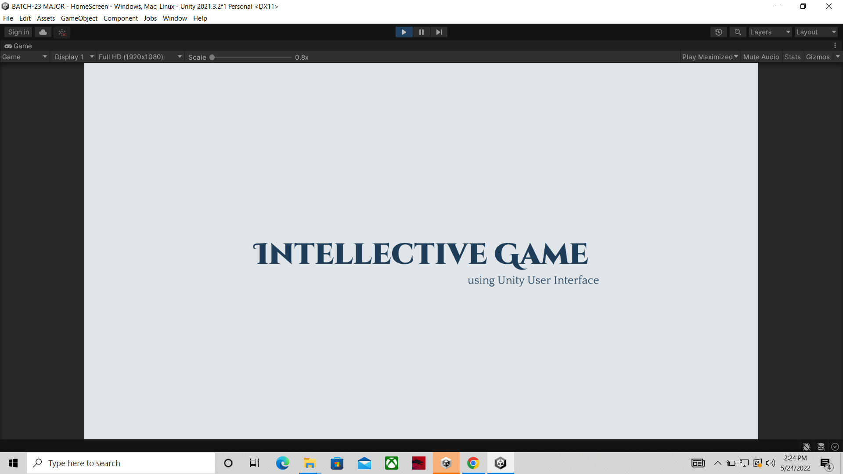
Results

Slide 20
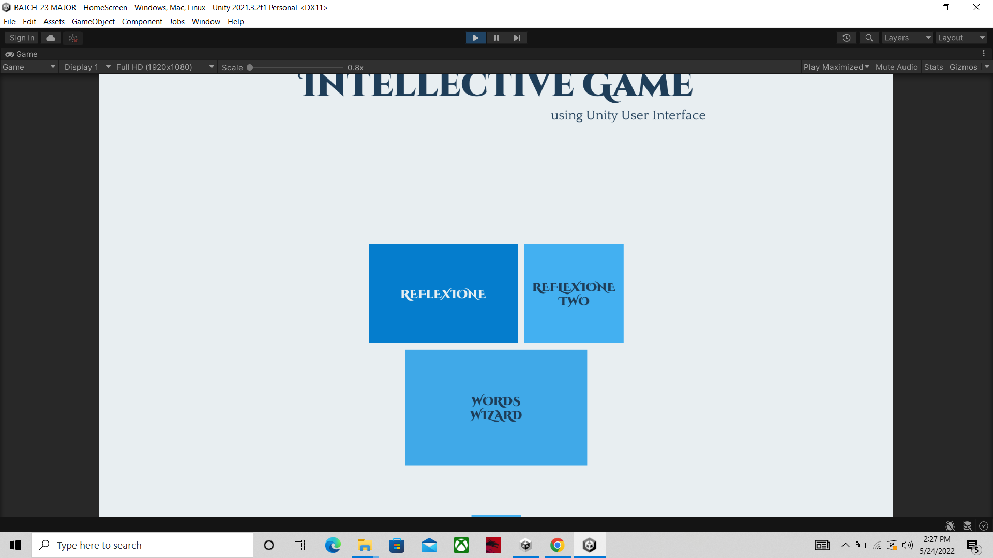

Slide 21
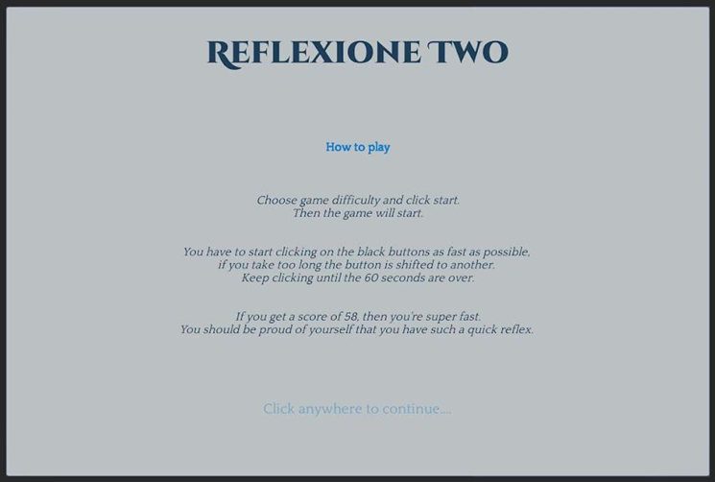

Slide 22
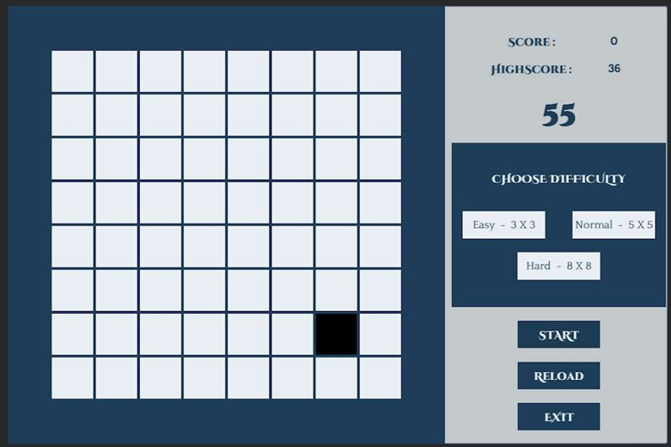

Slide 23
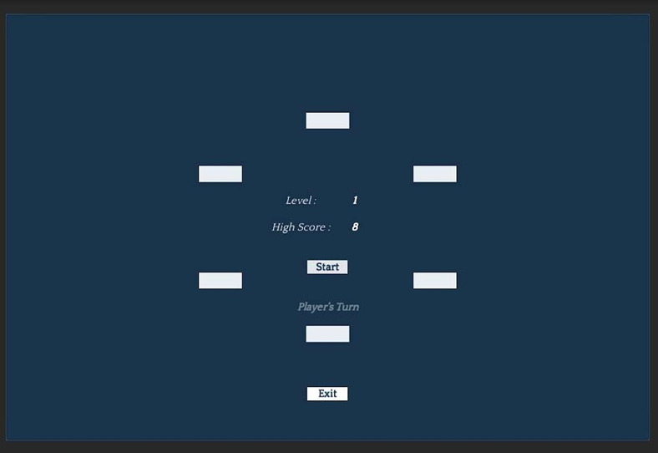

Slide 24
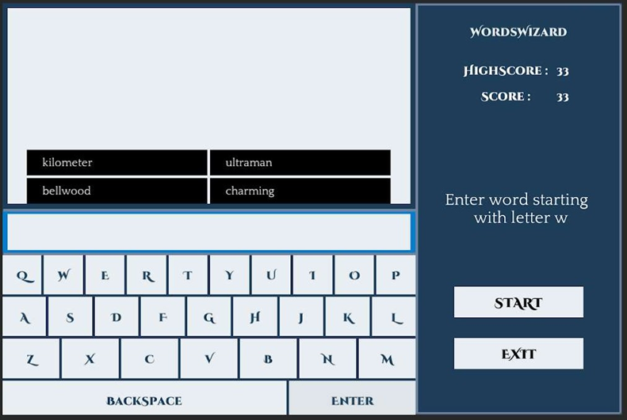

Slide 25
CONCLUSION
We developed a cognitive game using unity 2D tools.
Unity’s workflow is beginner friendly and easier to use. For every update and future versions the unity technologies are improving the unity engine.
The tools are easy to understand and work with. With good practice and moderate effort anyone can make games with stunning visuals.

Slide 26
FUTURE ENHANCEMENT
Unity releases its yearly LTS versions with new features every year. Because this engine is used solely for game development we can use its latest features to develop more immersive Interactive Applications.

Slide 27
THANK YOU

